Slide 1
Evaluating the pricing model of Big Mountain Resort to ensure profitability and sustain in market
Malleswari Gelli
Data Scientist

Slide 2
Scope/goal of this project
Re-evaluate the pricing model/strategy to estimate better ticket price of Big Mountain Resort to cover the operational expenses of $1.6M for installing additional chair lift by evaluating the facilities and service they provide

Slide 3
Problem Statement Worksheet (Hypothesis Formation)
How Big Mountain Resort restructures their pricing model of tickets to reflect the value of facilities they provide and compensate ~1.6M operation costs of additional chair lift by October 2020. This model in turn facilitates better understanding of what each facility is worth to customers and guide our investment strategy.
H
1
Context
4
Constraints within solution space
Big Mountain Resort in Montana, a sky resort offers spectacular views for skiing or snowboard. To distribute the crowd, resort installed additional chair lift, which added ~$1.6M operational costs. Their premium pricing was already above the average price of resorts in the market but is not capitalizing on its facilities as much as it could. So, Big Mountain resort wanted to restructure ticket prices while considering the facilities they provide in order to maximise the profits while remaining competitive in the market.
Limited data availability, what’s been provided is list of adult ticket prices and operations at Big Mountain resort and other resorts across united states. This limits the scope and facilitate analysis in relation to other resorts rather than analysing actual resort data related directly to increased revenue.
5
Stakeholders to provide key insight
2
Criteria for success
Company share holders, head of data analysis whom I will be reporting, Director of Operations, Jimmy Blackburn, and Alesha Eisen, the Database Manager. Also, operations and finance departments are stakeholders.
Primary target is increased ticket price at least by $1
Determine the features which facilitate cut costs without undermining the ticket price
6
Key data sources
3
Scope of solution space
1) skiResorts.csv file containing ticket prices, facility information, different features etc from both Big Mountain as well as 330 competitor resorts across US.
2) Also, some online information about demographics of every state.
3) Also, I can be able to reach out to stakeholders for information
Primary interest is to increase the ticket price. If needed, management would like to modify or improve operations so that increased price would appeal the customers.
H
D
E
I
P
Notes:
Hypothesis: Create a Hypothesis with an emphasis on SMART principles. (S – Specific, M – Measurable, A – Achievable, R – Realistic, T – Timebound). If you cannot do this, you do not have a good grasp on the business problem.
Context: With context, we have clearly identified the problem at hand and have elucidated on how our initiative may solve this problem, alongside the commercial implications this will have on the business.
Criteria for Success: Clearly defining the criteria for success ensures that the scope of your work is clearly defined and understood. Otherwise, if this isn’t defined – your work will never end which will result in mismatched expectations.
Scope of Solution Space: Scoping out the solution space ensures that the business initiative is SPECIFIC for a certain segment or area. This prevents solutions that have been developed being scaled and applied for all other business units that the solution may not be responsible or scalable for.
Constraints within Solution Space: Looking forward, what are the foreseeable problems we are likely to encounter? Could this be stakeholder resistance? Could this be we don’t have access to the right data?
Stakeholders to provide key insight: Who are the people I need to speak to, to get the answers I need for my data analysis?
What key data sources are required?
Based off my discussions with the key stakeholders – can we clearly list out all the data sources we need so we can make a highly targeted request as opposed to a scatter-gun approach where we ask for a bit of everything?

Slide 4
Recommendation and key findings
Comparing the data from 330 resorts across US shows that Big Mountain Resort (BMR) is currently charging $81 for utilizing different facilities, which is underpriced.
The model suggested a predicted ticket price increase from $81 to $95.87 +/-$10.39, which would increase the ticket price by $4.34/day/ticket to $25.4/day/ticket
Assuming 350000 visitors purchase 5-day passes (350,000*5*4.34= $7.595MM to 350,000*5*25.4=$44.450MM).
Besides increasing the ticket price, few alternatives to the facilities would aid in reducing the maintenance expenses and lead to increase revenue; for example
Model suggested that increasing the vertical drop by 150 feet, adding a run, and installing an additional chair lift increase ticket price by $1.99/day/customer would increase the revenue of (350000*5*1.99 = $3500MM)
Shutting down few least used runs, would save operational expenses though it wouldn’t impact the ticket price

Slide 5
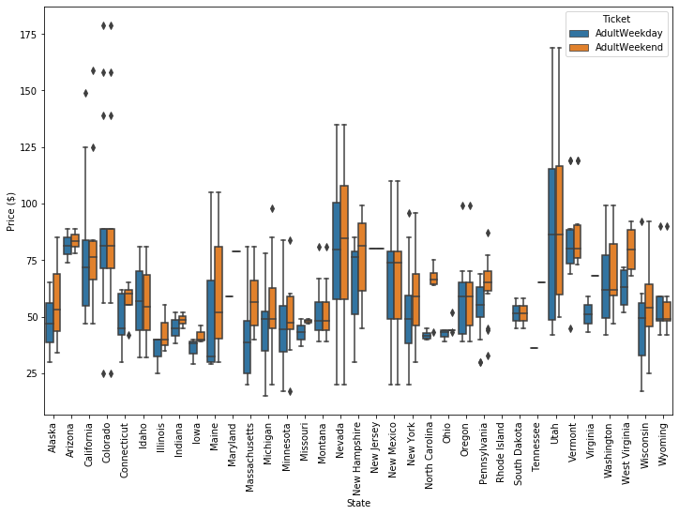
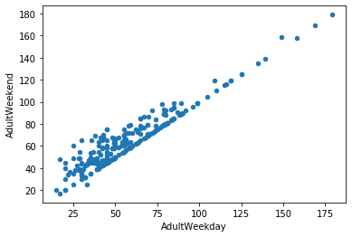
Datasets
ski_resort_data.csv, contains different resorts info across the country with 330 rows and 27 columns
AdultWeekend and AdultWeekday columns are weekend and weekday adult ticket price in dollars; so considered these columns as target variables
Boxplot distribution for weekday and weekend prices in Montana seemed equal
Relationship between weekday and weekend prices
For most states, ticket prices range of 25 to >$100. Besides, average weekend ticket price was higher than weekday price for all the states except Colarado, NewJersey, NewMexico, Montana, South Dakota.
weekend prices are higher for resorts pricing below $100; then same across
.
target feature, AdultWeekend ticket price

Slide 6
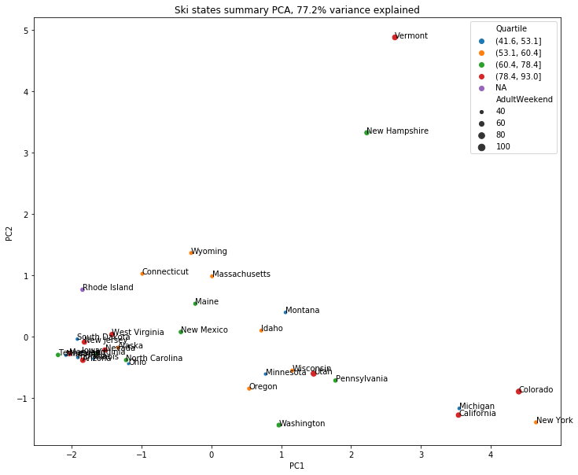
Dataset
state_summary
Contains # of resorts/state, total skiable area(acres), # of days open, state population etc.
Red points representing the upper quartile of price can be seen to the left, the right, and up top.
There's also a spread of the other quartiles as well.
In this representation of the ski summaries for each state, which accounts for some 77% of the variance, do not notice a pattern with price.
Combined two datasets for model prediction

Slide 7
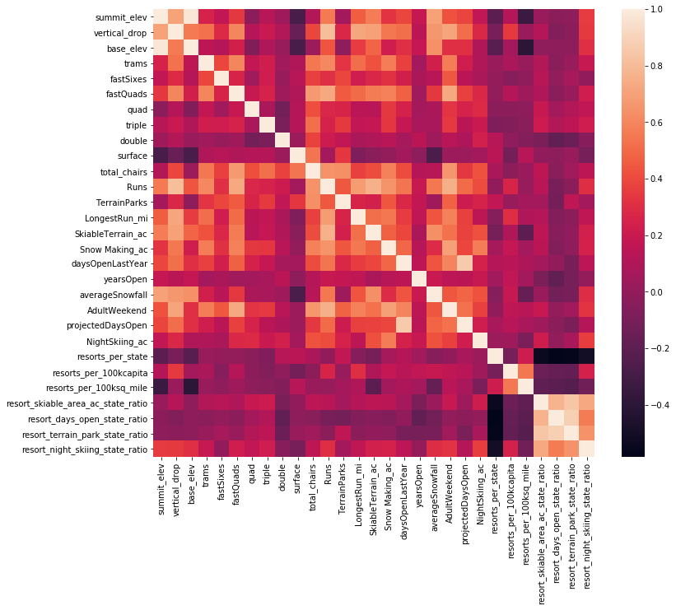
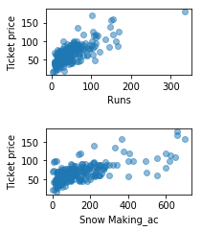
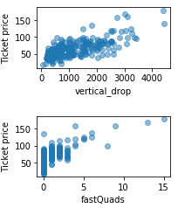
Correlation among features to dive into how ticket price varies with features
evaluating the relationship between different features of the resorts across United States to determine the target variable for modelling the ticket price
Target variable: AdultWeekend price is more positively correlated with
fastQuads,
Runs, total chairs
Snow Making_ac: Visitors would seem to value more guaranteed snow
vertical drop seems to be a selling point that raises ticket prices

Slide 8
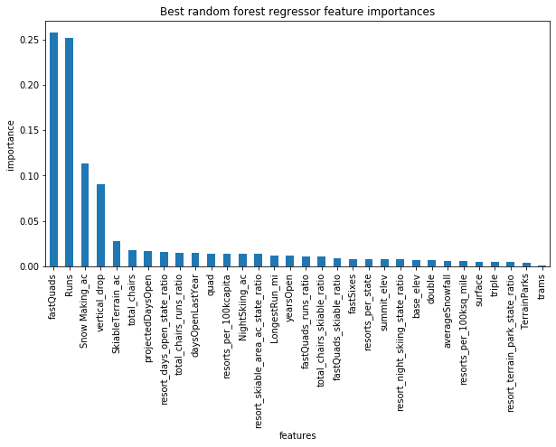
Model
split data into 70%, 30% of train, test sets respectively before training the model
Train model on training set
Predict the price of test set
Model | Predict value | R2 (Y_tr, Y-te) | MAE(Y-tr, Y-te)
Average mean as predictor | 63.8 | 0.0, -0.003 | 17.9, 19.1
Linear Regression
Random Forrest
the dominant top four features are in common with your linear model:
fastQuads
Runs
Snow Making_ac
vertical_drop
Feature | coefficients
vertical_drop | 10.767857
Snow Making_ac | 6.290074
total_chairs | 5.794156
FastQauds | 5.745626
Runs | 5.370555
LongestRun_mi | 0.181814
Trams | -4.142024
SkiableTerrain_ac | -5.24978

Slide 9
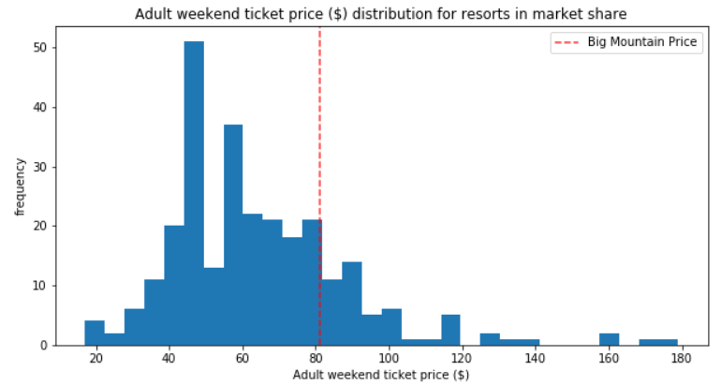
Summary and conclusion
Data from 330 resorts across US shows that Big Mountain Resort (BMR) is currently charging $81 for utilizing different facilities, which is underpriced
Of the 32 features evaluated in the study, there were 4 key features that impacted ticket prices the most, in order of impact: Fast Quads, Runs, Snow-making and Vertical Drop.
The model suggested a predicted ticket price increase from $81 to $95.87 +/-$10.39, which would increase the ticket price by $4.34/day/ticket to $25.4/day/ticket).
Assuming 350000 visitors purchase 5-day passes (350,000*5*4.34= $7.595MM to 350,000*5*25.4=$44.450MM).

Slide 10
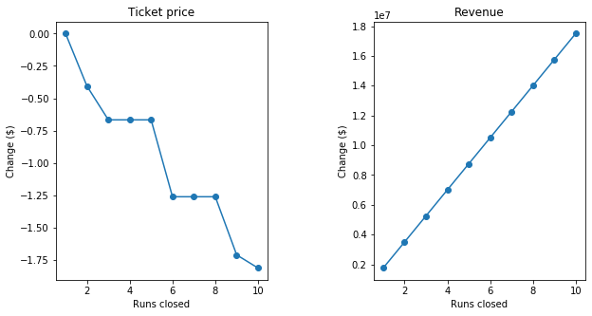
Summary and conclusion
Effect of closing runs on ticket price and revenue change:
Closing one run makes no difference. Closing 2 and 3 successively reduces support for ticket price and so revenue.
If Big Mountain closes 3 runs, may as well close 4 or 5 as there's no further loss in ticket price. Increasing the closures down to 6 or more leads to a large drop.

Slide 11
Recommendations
As suggested by the model, initially increase the ticket price from $81 to $85.34/day/customer and monitor the daily increase of revenue and validate with recent sale information. If continues, increase the price to maximum of $106.40.
Closing down one of the least used runs which may not have a direct impact on ticket price. However, closing a run would reduce the operational expenses, which intern is added to the revenue. As the model suggests, recommend to close more least used runs after seeing the value gain of closing one.
Model suggested that increasing the vertical drop by 150 feet, adding a run, and installing an additional chair lift increase ticket price by $1.99/day/customer would increase the revenue. However, requires validation by including full financial data into the analysis.

